Slide 1

St. Andrew Greek orthodox church June 2026 parish swot results & Sentiment insights
Prepared by St. Andrew Parish Council Executive Team

Slide 2
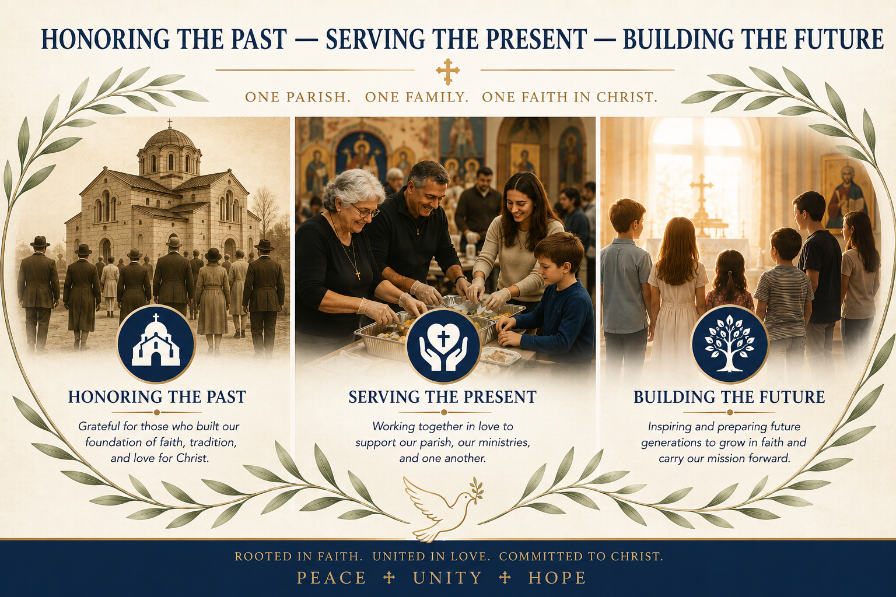
St. Andrew Greek Orthodox Church
Randolph, New Jersey
June 2026

Slide 3
General Survey Data
Number of St. Andrew Stewardship Respondents: 82
Number of St. Andrew Stewardship Families: 450
Response Rate: 18.22%
Survey Dates: April 1 – May 9, 2026
Type of Survey Results/Insights: NPS – Adapted Net Promoter Score & Parish Sentiment Results
For a Parish such as St. Andrew Greek Orthodox Church, Parish Sentiment can help leadership understand:
How connected parishioners feel
Confidence in parish direction
Satisfaction with worship and parish life
Trust in stewardship and leadership
Willingness to support future initiatives
Leadership General Guidance:
While not every parishioner participated, the survey provides meaningful feedback and valuable insight into the priorities and concerns of many engaged members of our parish community.
The results should be viewed as directional guidance to help leadership listen, plan responsibly, and continue parish dialogue.

Slide 4
Parish Sentiment Methodology
Promoters
These are highly supportive parishioners who:
Feel emotionally connected
Support the parish mission
Volunteer and contribute
Speak positively about the church
Often support future initiatives
Passives
These members are generally satisfied but:
Less emotionally engaged
Less likely to advocate publicly
More cautious about change or investment
May participate inconsistently
Detractors
These members may:
Feel disconnected
Have unresolved frustrations
Be skeptical of leadership or direction
Resist projects or change
Spread negative sentiment unintentionally

Slide 5
Overall Parish Sentiment
Adapted Parish NPS Score: 19.9%
Promoter-style comments: 133
Passive-style comments: 79
Detractor-style comments: 199
General: The parish is still fundamentally intact, people still care deeply, but there are visible organizational and emotional stress points. Typical Religious and Non-Profit institutions score between 20 and 40%
The encouraging part is that our survey showed: Many people still emotionally love the parish, care about Orthodoxy, appreciate ministries, and want the church to succeed.
The risk area is the large passive group: People who are not against the church, but are becoming tired, skeptical, disengaged, or uncertain.

Slide 6
Community & Fellowship
Mentions: 75
Positive-oriented mentions: 37
Negative-oriented mentions: 34
Passives: 4
This emerged as the strongest emotional theme in the survey. Parishioners consistently described St. Andrew as a welcoming, caring, and family-oriented community with strong interpersonal bonds and shared faith identity.
Key Insights
Community identity remains one of the parish’s greatest strengths.
Many parishioners stay connected primarily because of relationships and fellowship.
Negative comments often centered around interpersonal tensions, cliques, or occasional conflict rather than lack of community itself.
Preserving unity and reducing internal division should remain a strategic priority.
Strategic Opportunity
Strengthen parish-wide fellowship activities that intentionally bridge:
Generations,
Ministries,
Newer parishioners,
and long-time stewards.

Slide 7
Volunteerism & Ministries
Mentions: 58
Positive-oriented mentions: 27
Negative-oriented mentions: 27
Passives: 4
Volunteerism and ministry participation remain major pillars of parish life. Many respondents acknowledged the dedication and sacrifice of ministry leaders and volunteers.
Key Insights
Ministries are viewed as essential to parish vitality.
Volunteers are appreciated but may also be experiencing burnout.
Some respondents perceive unequal participation or organizational silos between ministries.
Coordination and communication gaps occasionally reduce effectiveness.
Strategic Opportunity
Develop:
Stronger ministry coordination,
Volunteer appreciation efforts,
Leadership succession planning,
and clearer ministry support processes.

Slide 8
Spiritual Leadership & Clergy
Mentions: 46
Positive-oriented mentions: 23
Negative-oriented mentions: 19
Passives: 4
The clergy and spiritual foundation of the parish generated strong emotional attachment and appreciation. Many respondents expressed gratitude for Orthodox worship, sacramental life, and spiritual guidance.
Key Insights
Parishioners deeply value the Orthodox faith tradition.
Positive sentiment toward spiritual life remains a stabilizing force.
Some concerns appeared regarding execution, communication style, and parish politics rather than theology or faith itself.
The spiritual mission of the church remains highly respected.
Strategic Opportunity
Continue emphasizing:
Pastoral accessibility,
Spiritual education,
Prayer life,
and visible unity between clergy and lay leadership.

Slide 9
Youth & Young Adult Engagement
Mentions: 35
Positive-oriented mentions: 5
Negative-oriented mentions: 27
Passives: 3
This was one of the strongest strategic concern areas identified in the survey. Many respondents expressed anxiety regarding long-term parish sustainability and the future involvement of younger generations.
Key Insights
Concerns exist about retaining youth after high school or college.
Respondents want stronger youth programming and engagement opportunities.
There is concern about future generational continuity within the parish.
Families value Orthodoxy but fear younger generations may disconnect.
Strategic Opportunity
Expand:
GOYA and young adult ministry,
Mentorship opportunities,
Family-oriented events,
and leadership development for younger parishioners.

Slide 10
Greek Culture & Language
Mentions: 33
Positive-oriented mentions: 7
Negative-oriented mentions: 24
Passives: 2
Parishioners continue to place strong emotional importance on preserving Greek Orthodox traditions, language, and cultural identity.
Key Insights
Greek identity remains deeply valued.
Some respondents fear cultural dilution.
Others expressed concern about balancing Greek heritage with broader outreach and inclusiveness.
The survey suggests the parish is navigating a sensitive balance between tradition and growth.
Strategic Opportunity
Frame Greek heritage as:
Spiritually enriching,
Welcoming,
and foundational to Orthodox identity, while remaining accessible to future generations and non-Greek Orthodox Christians.

Slide 11
Governance & Leadership
Mentions: 28
Positive-oriented mentions: 9
Negative-oriented mentions: 18
Passives: 1
Leadership generated mixed sentiment. Many respondents appreciate the dedication of parish leaders, while others expressed concerns about communication, transparency, politics, and organizational effectiveness.
Key Insights
Parishioners want stronger organizational clarity and accountability.
Transparency and consistency matter greatly to trust levels.
Political tension and historical frustrations continue to influence perceptions.
Leadership fatigue and distrust may still linger from prior experiences.
Strategic Opportunity
Focus on:
Transparent communication,
Visible planning,
Regular updates,
and collaborative leadership culture.

Slide 12
Stewardship & Finance
Mentions: 21
Positive-oriented mentions: 2
Negative-oriented mentions: 19
Passives: 0
Financial stewardship remains a sensitive but important topic. Parishioners understand the financial realities facing the church but desire greater clarity and communication.
Key Insights
Stewardship discussions can trigger emotional reactions.
Some respondents expressed concern regarding financial sustainability.
Others want clearer explanations of parish financial needs and priorities.
Parishioners appear more supportive when they understand the “why.”
Strategic Opportunity
Increase:
Stewardship education,
Financial transparency,
Project visibility,
and communication around operational costs and ministry impact.

Slide 13
Choir, Chanting & Worship Experience
Mentions: 16
Positive-oriented mentions: 7
Negative-oriented mentions: 8
Passives: 1
Worship experience generated highly emotional feedback. Parishioners care deeply about liturgical quality, reverence, chanting, choir participation, and preserving Orthodox worship traditions.
Key Insights
Worship quality strongly shapes parish satisfaction.
Some comments reflected tension regarding chanting style, choir execution, or congregational participation.
Liturgical identity remains emotionally important to parishioners.
Traditional Orthodox worship is viewed as central to parish identity.
Strategic Opportunity
Consider:
Worship improvement discussions,
Choir support,
Chant education,
and increased congregational engagement.

Slide 14
Communication & Transparency
Mentions: 13
Positive-oriented mentions: 0
Negative-oriented mentions: 7
Passives: 6
Communication gaps emerged repeatedly throughout the survey and affected overall organizational confidence.
Key Insights
Parishioners want more consistent updates and clearer messaging.
Lack of communication sometimes creates assumptions, suspicion, or frustration.
Respondents generally prefer openness even when discussing difficult issues.
Communication quality strongly influences trust in leadership.
Strategic Opportunity
Develop:
Recurring parish updates,
Dashboards,
Ministry communications,
and centralized information-sharing processes.

Slide 15
Facilities, Safety & Maintenance
Mentions: 9
Positive-oriented mentions: 6
Negative-oriented mentions: 1
Parishioners recognize the importance of maintaining church facilities and ensuring a welcoming physical environment.
Key Insights
Visible maintenance issues affect parish confidence.
Parking, accessibility, and aesthetics were recurring concerns.
Parishioners generally support practical and visible improvements.
Safety and upkeep influence first impressions and hospitality.
Strategic Opportunity
Prioritize:
Phased beautification projects,
Preventative maintenance,
Safety improvements,
and highly visible upgrades that build confidence and momentum.

Slide 16
Growth & Outreach
Mentions: 14
Positive-oriented mentions: 8
Negative-oriented mentions: 0
Passives: 0
Many respondents expressed desire for parish growth, stronger outreach, and broader engagement with the surrounding community.
Key Insights
Parishioners want the church to grow while preserving Orthodox identity.
Outreach efforts are viewed as necessary for long-term sustainability.
Respondents support attracting younger families and new stewards.
Evangelism remains an opportunity area rather than a current strength.
Strategic Opportunity
Strengthen:
Newcomer integration,
Digital presence,
Outreach ministries,
and family/community engagement initiatives.

Slide 17
Insights & Reflections
The St. Andrew Voice Survey reflects a parish that remains deeply rooted in faith, community, and Orthodox identity, while also navigating many of the same challenges facing churches throughout America today. The survey results do not indicate a parish in crisis; rather, they reveal a parish at an important moment of transition, reflection, and opportunity.
The strongest message throughout the responses is that parishioners genuinely love St. Andrew Greek Orthodox Church. There remains a strong emotional attachment to the spiritual mission of the Church, the liturgical life of Orthodoxy, the parish community, volunteer ministries, and the preservation of Greek Orthodox traditions. These foundational strengths provide the parish with a stable platform upon which future growth can occur.
At the same time, the survey highlights several important realities that leadership must address thoughtfully and transparently. Concerns regarding communication, organizational alignment, youth engagement, volunteer fatigue, financial confidence, and long-term sustainability reflect a desire among parishioners not simply to preserve the parish, but to strengthen it for future generations.

Slide 18
St. Andrew Beautification survey results
Area | Average Score (Satisfied =3; Neural = 2; Dissatisfied = 1)
Orthodox Identity of Exterior/Η εξωτερική εμφάνιση της Εκκλησίας | 2.12
Function of Drop Off to Church/Η πρόσβαση για τα αυτοκίνητα (Drop off) | 2.15
Exo-Narthex / Front Door/Η κεντρική είσοδος | 2.2
Size and Function of Narthex/Ο χώρος του Νάρθηκα (το μέγεθος & η χρήση του) | 2.24
Environment of Nave and Dome/Ο Κυρίως Ναός και ο Τρούλος | 2.43
Sanctuary and Icon Screen/Το Ιερό και το Εικονοστάσιο (Τέμπλο) | 2.67
Other Liturgical Furnishings/Τα υπόλοιπα έπιπλα της Εκκλησίας | 2.57
This report summarizes the parish beautification survey and highlights key satisfaction trends and strategic insights.

Slide 19
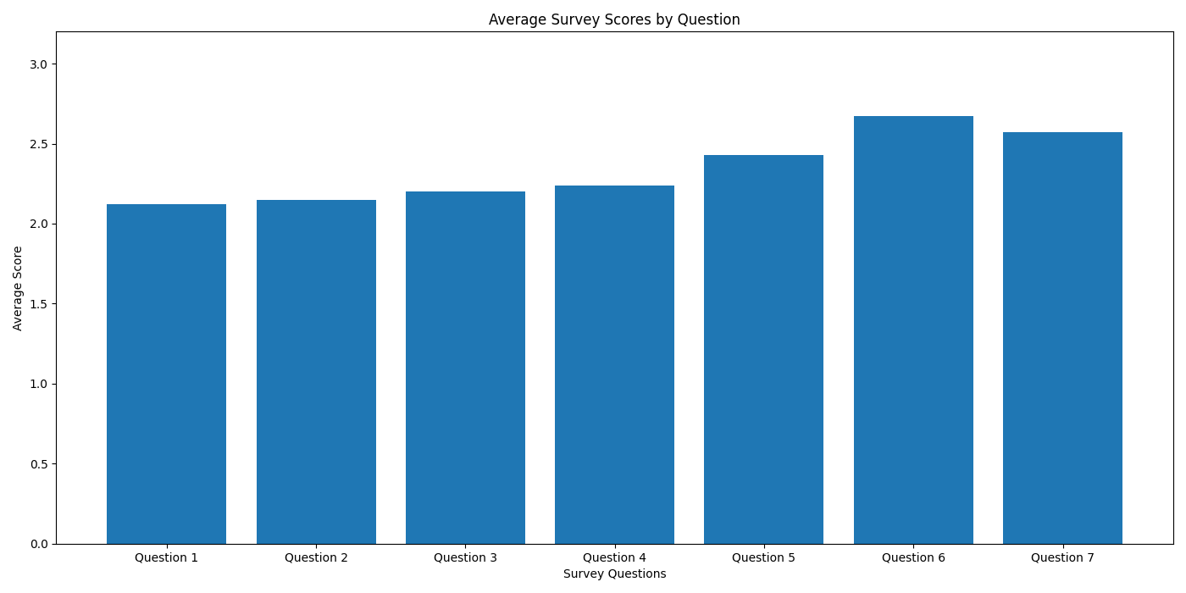
Orthodox Identity of Exterior
Function of Drop Off to Church
Exo-Narthex / Front Door/
Size and Function of Narthex
Environment of Nave and Dome
Sanctuary and Icon Screen
Other Liturgical Furnishings

Slide 20
St. Andrew Beautification survey results
The survey results indicate stronger support for practical beautification and hospitality improvements rather than disruptive large-scale redevelopment.
Parishioners appear to place high value on preserving the spiritual atmosphere and Orthodox identity of the church.
Exterior appearance, entrances, accessibility, and first impressions appear to be key opportunities for improvement.
The data suggests the parish may be more comfortable supporting phased and visible improvements before considering major capital campaigns.
Visible smaller projects can help build confidence, trust, and momentum for future investments.
Key Parish Insights

Slide 21
St. Andrew Beautification survey results
Lowest Rated Areas
Orthodox Identity of Exterior/Η εξωτερική εμφάνιση της Εκκλησίας
Function of Drop Off to Church/Η πρόσβαση για τα αυτοκίνητα (Drop off)
Exo-Narthex / Front Door/Η κεντρική είσοδος
Highest Rated Areas
Other Liturgical Furnishings/Τα υπόλοιπα έπιπλα της Εκκλησίας
Sanctuary and Icon Screen/Το Ιερό και το Εικονοστάσιο (Τέμπλο)
Environment of Nave and Dome/Ο Κυρίως Ναός και ο Τρούλος
Key Parish Insights – Double Click

Slide 22
St. Andrew Beautification survey results
The survey suggests that parishioners are likely willing to support improvements that are practical, visible, and tied to hospitality, accessibility, and parish pride.
The data does not strongly suggest immediate appetite for extremely large or risky capital projects. A phased beautification strategy may therefore be the most successful path forward.
Leadership may benefit from emphasizing stewardship, transparency, volunteer involvement, and preservation of Orthodox identity when discussing future improvements.
Recommended Strategic Direction

